Slide 1
TensorFlow Features in Images, Part 2
COMP 4230

Slide 2
ALERTS
Turn in work for Lab 1 by Friday
Lab 2 will be on Friday
Read Chapter 3 of Moroney
Read Chapter 9 of Larson

Slide 3
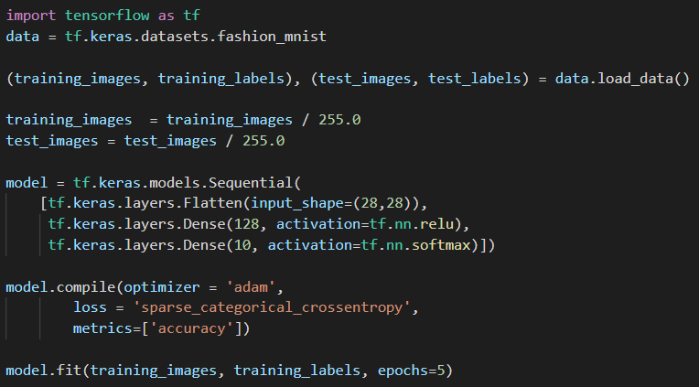
Let's Review: What is going on here...?

Slide 4
CNN: Modularity and Building blocks
The good news is that we can start with this code as the foundation and stack additional layers onto the neural net design
Convolutional layers:
tf.keras.layers.Conv2D (API)
Pooling layers:
tf.keras.layers.MaxPooling2D (API)

Slide 5
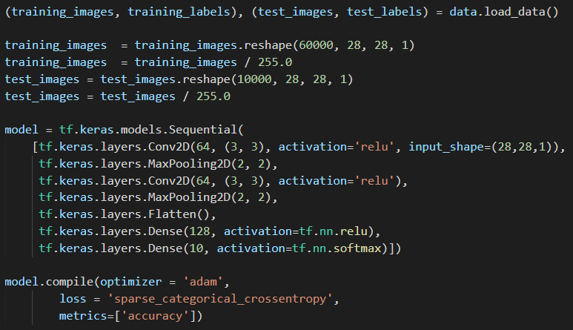
CNN: What's different?
Let's try both...

Slide 6
CNN: Looking under the hood
model.summary()
Let's try that out too...

Slide 7
A Programmer's Guide
ML Zero to Hero, Part 4

Slide 8
Keras ImageDataGenerator
We need to install SciPy in order for this to work
python3 –m pip install --upgrade scipy
Then our Python script will have to do the following
Download the training images (separate script recommended)
Use the ImageDataGenerator from Keras to import the images
Generating a training set from the IDG images
Build a giant model to train!

Slide 9
Training, Validation, & Testing
Training data
data that is used to teach the network how the data and labels fit together
Validation data
used to see how the network is doing with previously unseen data while you are training—i.e., it isn’t used for fitting data to labels, but to inspect how well the fitting is going
Testing data
used after training to see how the network does with data it has never previously seen

